Slide 1

Chatbot Using Machine Learning in Jupyter Notebook
Names: Anushka Dutta & Yash Pandey
KIIT University, Cranes Varsity (Batch 49)

Slide 2

Introduction
What is a Chatbot?
A chatbot is an AI-based software that can simulate a conversation with users in natural language through messaging applications, websites, or mobile apps.
Why use Jupyter Notebook?
Jupyter Notebook provides an interactive environment for developing and testing machine learning models, making it ideal for chatbot prototyping.

Slide 3
Problem Statement & Objective
Challenge: Building an intelligent chatbot that can understand user queries and provide relevant responses.
Goal: To develop a machine learning-based chatbot using Python and Jupyter Notebook.
Impact: Enables interactive, automated conversations for various applications (education, customer service, etc.).

Slide 4
Dataset Overview
Data Source: Custom intents JSON file (defines user intents and responses).
Features:
User input sentences (utterances)
Corresponding intent tags
Predefined responses for each intent
Dataset Size: Typically small for demo chatbots; can be expanded for real-world use.

Slide 5

Data Preprocessing
Tokenize and vectorize user input sentences.
Encode intent labels.
Pad sequences for uniform input length.
Example code snippet:
PYTHON
tokenizer = Tokenizer(num_words=1000)
tokenizer.fit_on_texts(all_sentences)
X = tokenizer.texts_to_sequences(all_sentences)
X = pad_sequences(X, maxlen=10)

Slide 6
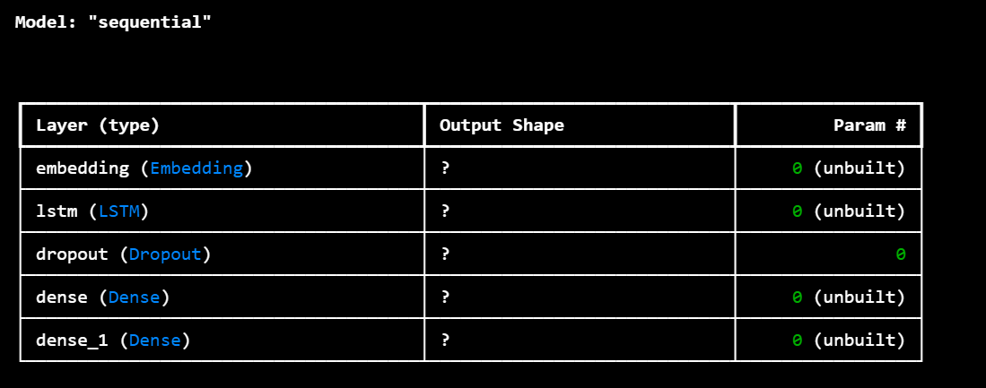
Model Architecture
Model Type: Sequential Neural Network (Keras)
Layers:
Embedding Layer
LSTM Layer
Dropout Layer
Dense (ReLU) Layer
Dense (Softmax) Output Layer

Slide 7
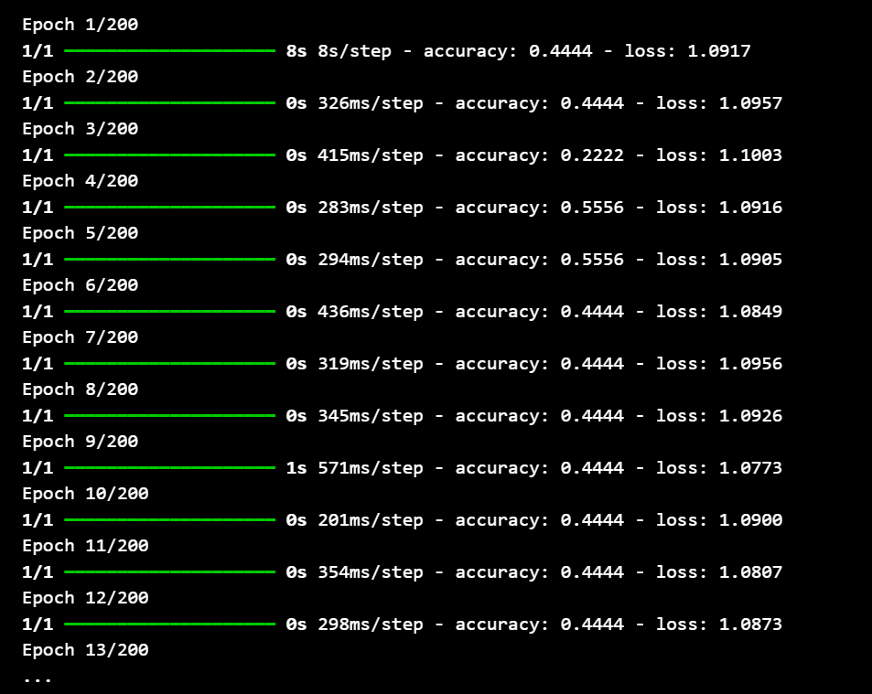
Training the Model
Loss Function: Sparse Categorical Cross Entropy
Optimizer: Adam
Epochs: 200

Slide 8
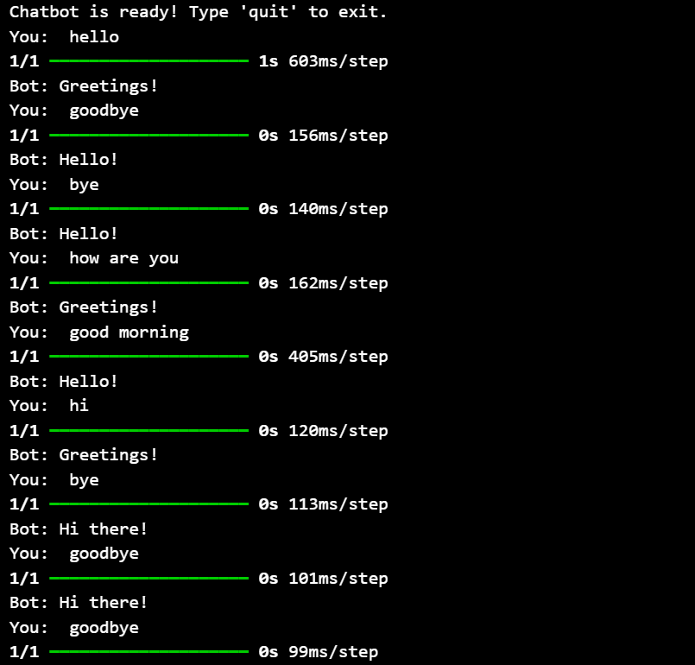
Chatbot Inference
Load the trained model
and required encoders.
Predict intent from user input.
Select a random response from
the predicted intent.

Slide 9
Results
Model Performance:
Final accuracy (as seen in training logs; e.g., up to 100% on small demo data)2.
Insights:
Model learns to map user queries to correct intents.
Performance improves with more training data and intents.

Slide 10
Comparative Analysis
Analysis
Feature | Chatbot (ML in Jupyter) | Traditional Rule-based Bot
Learning Ability | Yes (via data) | No
Flexibility | High | Low
Scalability | High | Low
Customization | Easy | Moderate

Slide 11
Conclusion
Successfully developed a simple chatbot using machine learning in Jupyter Notebook.
Demonstrated end-to-end workflow: data prep, model building, training, and inference.
Future work: Expand intents, use larger datasets, integrate with web/mobile apps.

